Slide 1
Face Mask Detection
Evan Luu

Slide 2

Background
Covid
Health Safety

Slide 3
Metrics
Success Metrics
Stakeholders
Constraints

Slide 4
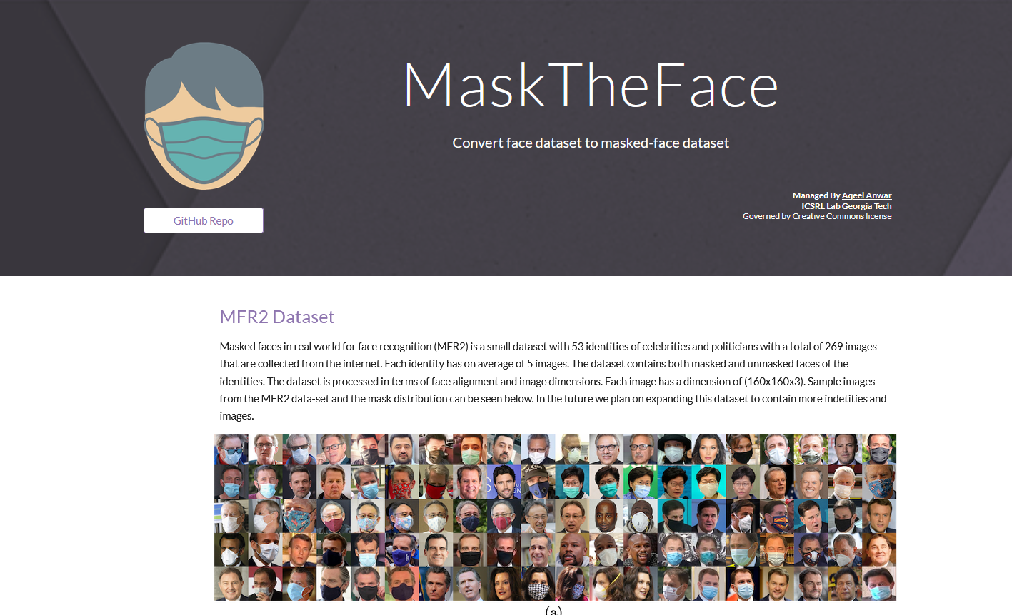
How is it related to Data Science?
The Problem
Data Set (MFR2)

Slide 5
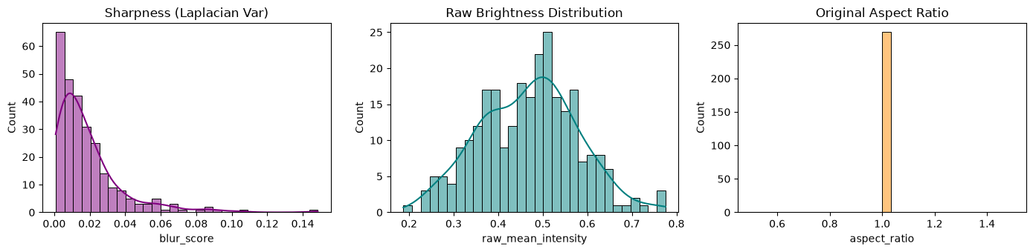
Data Wrangling
Key Findings

Slide 6
Exploratory Analysis
Image Aspects

Slide 7

Modeling Creation
Model Background
Model Creation
Model Reasoning

Slide 8
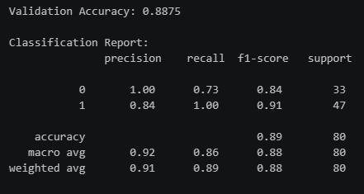
Analysis Results
Model Results
Alternatives

Slide 9
Recommendations
Use a predefined model
Continue work

Slide 10
Future Work
Improve the pipeline
Diversify the data

Slide 11
Thank You

